Slide 1

MLB Stats Predictor
Presented by:
Mireille Nehme
Nathalie ouellette
Samuel van noppen
Wyatt Baldwin

Slide 2
Content
Goal
BAseball Overview
Data
Model
Analysis
What’s Next?
https://www.stack.com/a/base-stealing/

Slide 3
Goal
Predict whether an MLB runner will be able to successfully steal a base based on various aspects.
Predict next BsR number (Base Running) for batters.
Predict next WAR number (Wins Above Replacement) for pitchers
Visualize previous baseball games
Create a webpage to visualize the results.

Slide 4
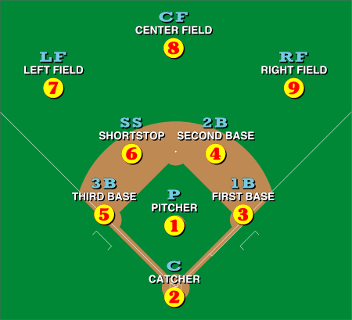
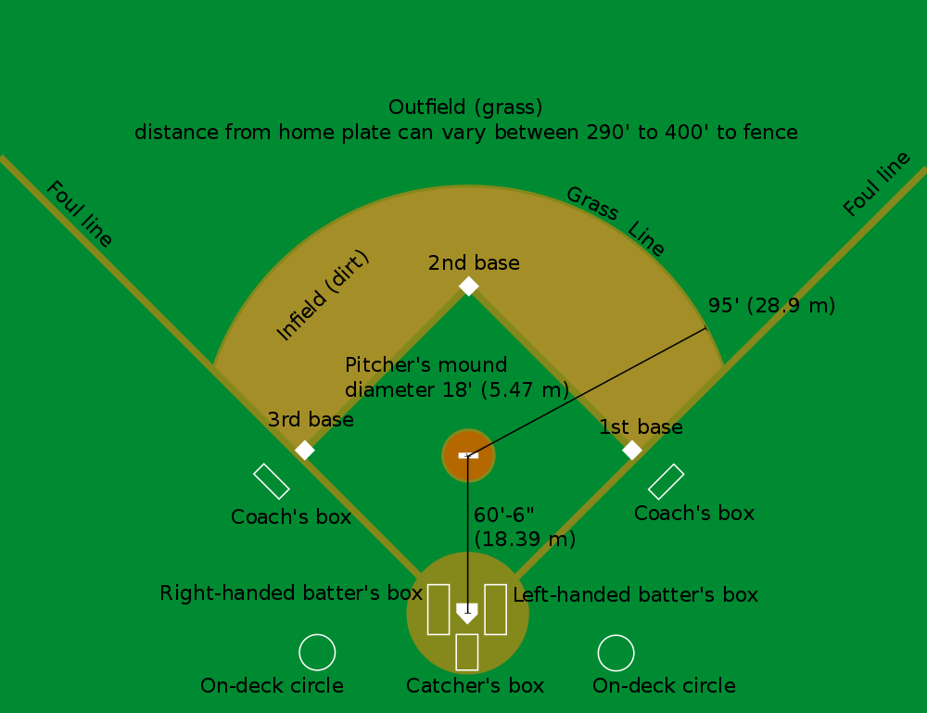
Baseball overview
https://en.wikipedia.org/wiki/Baseball_field
1st strike, 2nd strike, 3rd strike
And you’re out !!
Notes:
9 players per team

Slide 5

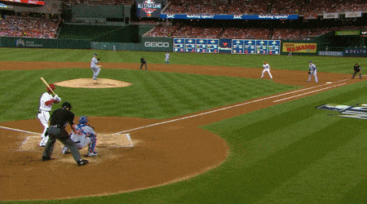
Stealing Bases
1
3
https://gfycat.com/gleamingickyhorsemouse
2
Notes:
9 players per team

Slide 6
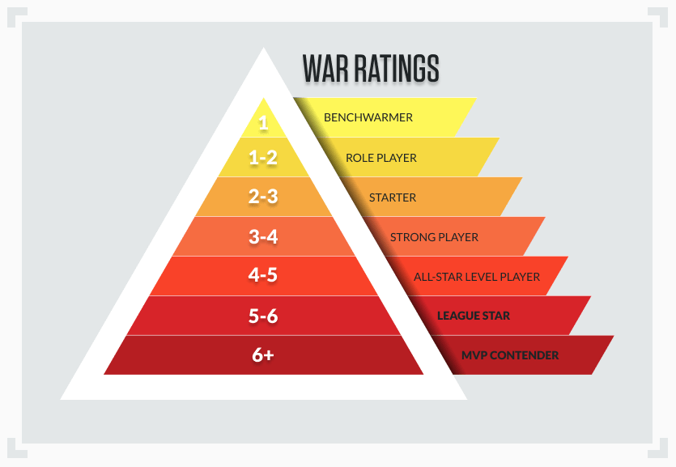
WAR
Wins Above Replacement is a number that measures a player's value in all facets of the game by deciphering how many more wins he's worth than a replacement-level player at his same position.
The higher the WAR number, the better the stat.
https://www.sportsbettingdime.com/guides/how-to/war-baseball-betting/
Notes:
9 players per team

Slide 7
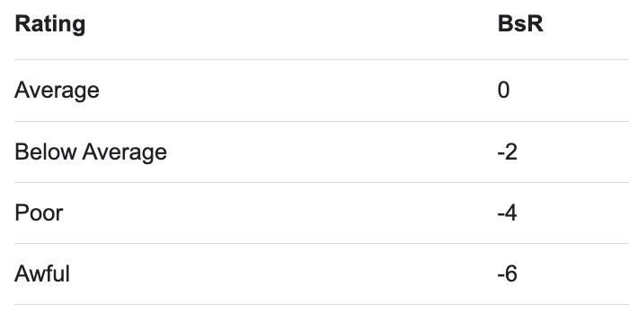
BsR
Base running is the base running component of WAR at FanGraphs.
It's a number that calculates the player's ability to steal the bases.
https://library.fangraphs.com/offense/bsr/
Notes:
9 players per team

Slide 8

Data
Data source: pybaseball
It is a Python package for baseball data analysis.
from pybaseball import batting_stats
from pybaseball import pitching_stats
from pybaseball import schedule_and_record

Slide 9
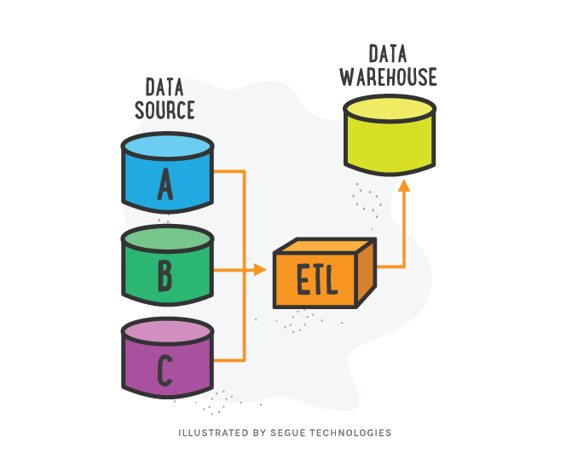
Data

Slide 10
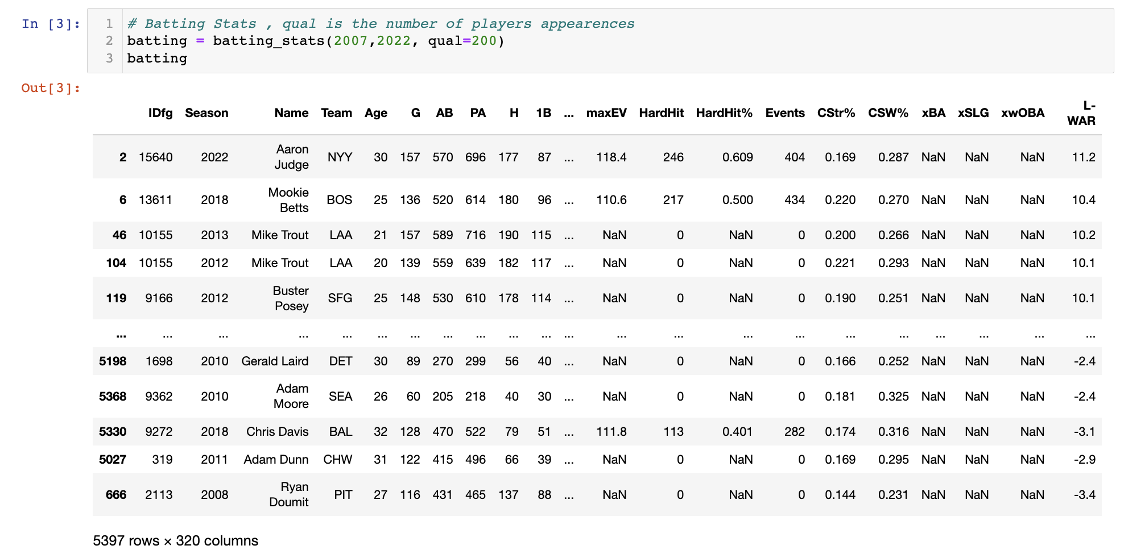
Data – 1st Dataset
Batters Stats

Slide 11
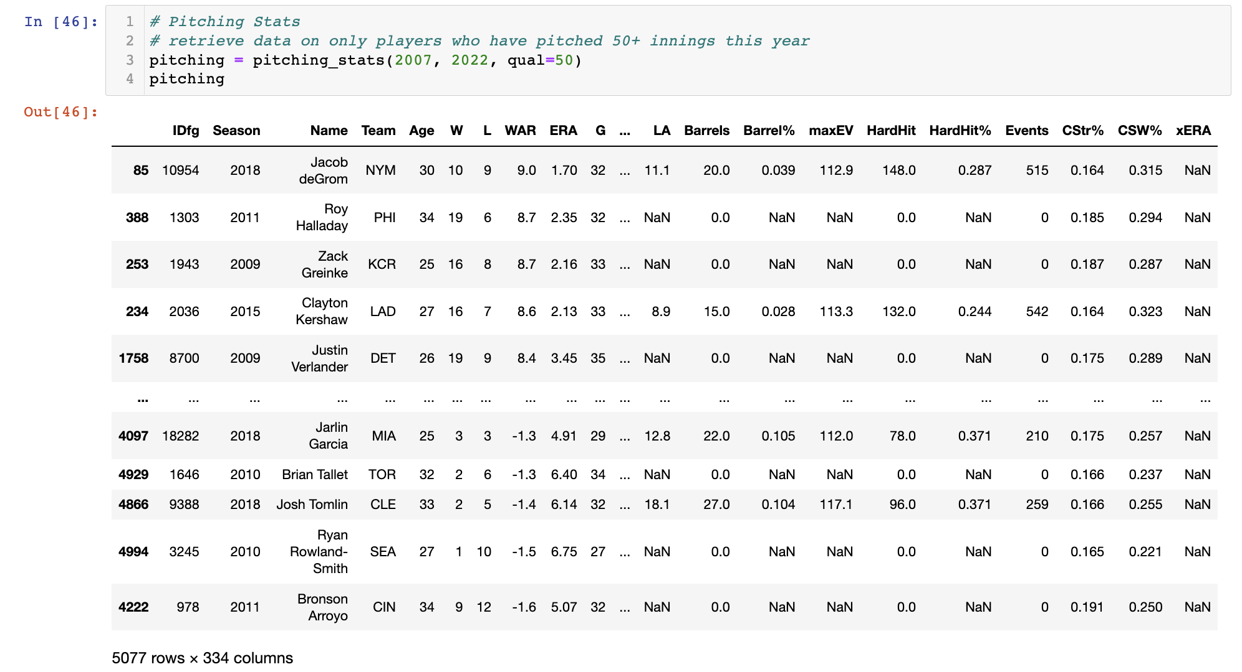
Data – 2nd Dataset
Pitchers Stats

Slide 12

Model
Train Ridge Regression Model
Initialize the model.
Use sequential features selector SequentialFeatureSelector to find the best features for the model.
The number of features selected was 20.
Use TimeSeriesSplit to make sure we are using previous data to predict future one.
Scale the data using MinMaxScaler
To iterate the model through all years we have created a function that will go through each year, assign train data as all previous years and test data as current year. The output of this function is a DataFrame of actual and predicted BsR numbers.

Slide 13
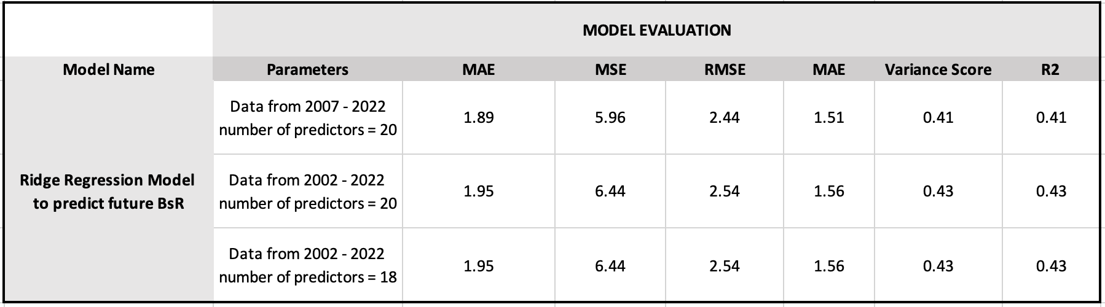
Analysis

Slide 14
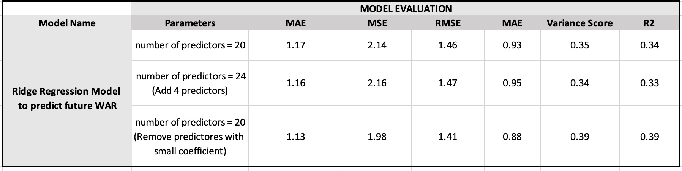
Analysis

Slide 15
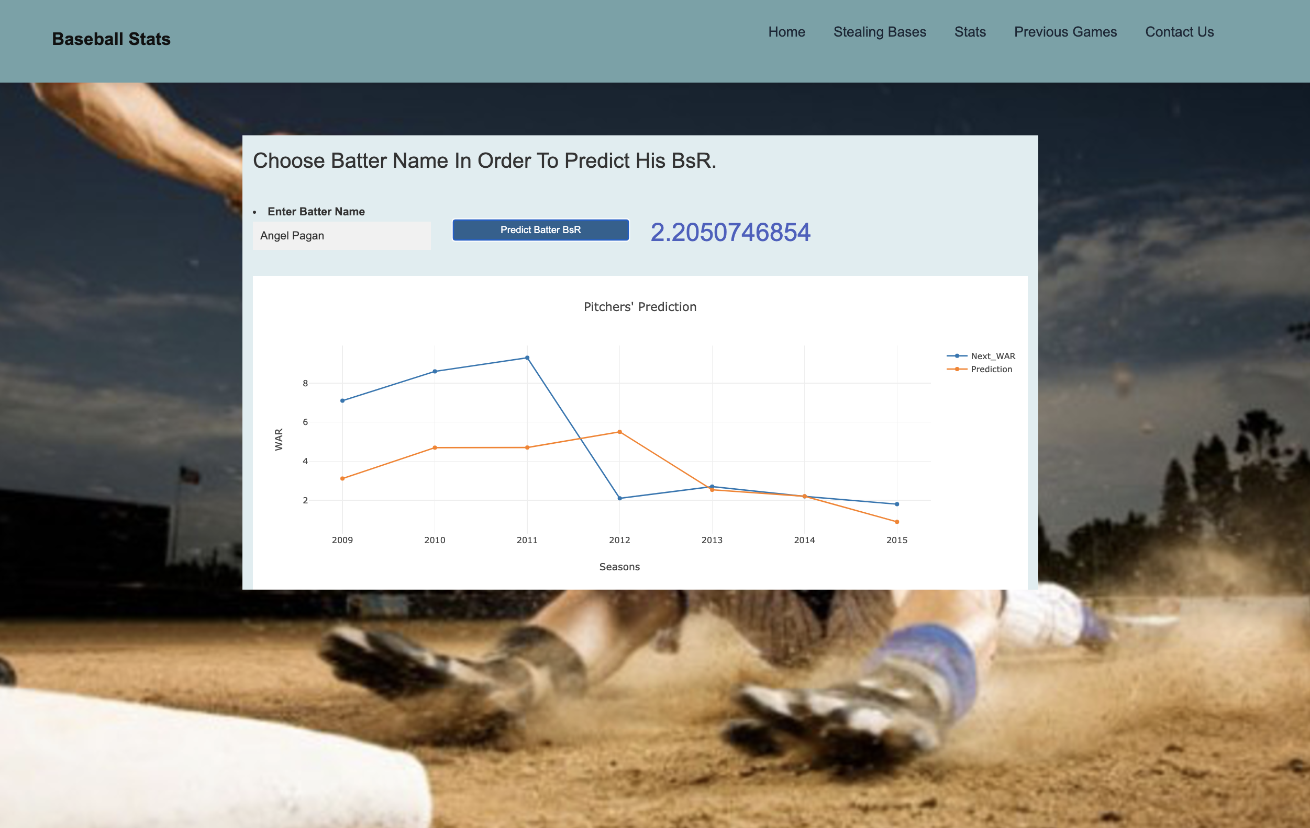

Visualization

Slide 16


Slide 17

Questions ?

